Slide 1
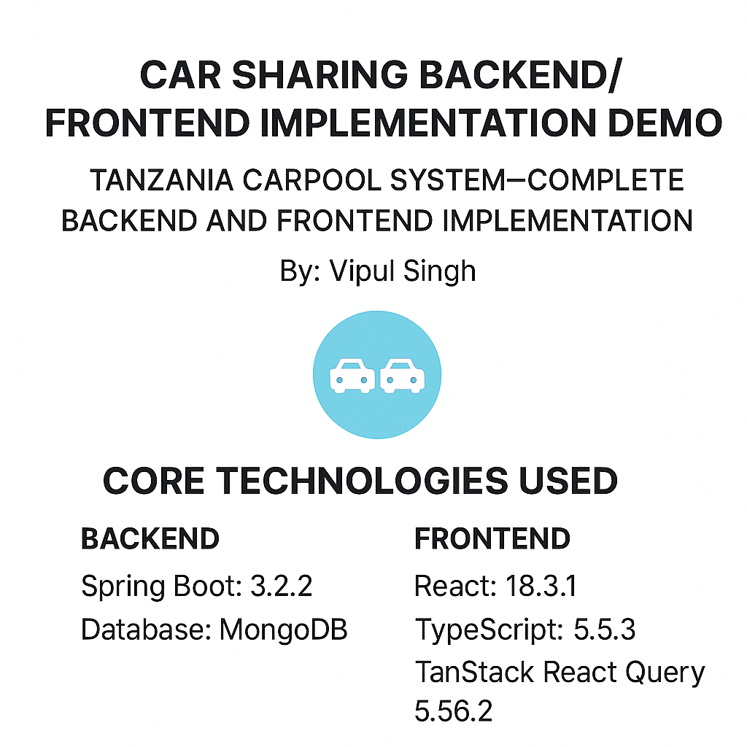
Car sharing Backend/Frontend Implementation Demo

Slide 2
User Authentication System
Registration Process:
Collects essential user details (name, email, password, phone)
Assigns unique user ID based on email (lowercase)
Stores securely in MongoDB database
Login Authentication:
Email and password verification
Returns user profile details and authentication status
Provides meaningful error messages (wrong password, user not found)
API Endpoints:
POST /api/users/signup: Creates new user accounts
POST /api/users/login: Authenticates existing users
GET /api/users/{userId}: Retrieves user profile information
Integration with Vehicle Management:
Users can register vehicles after account creation
Vehicle details linked to user accounts

Slide 3
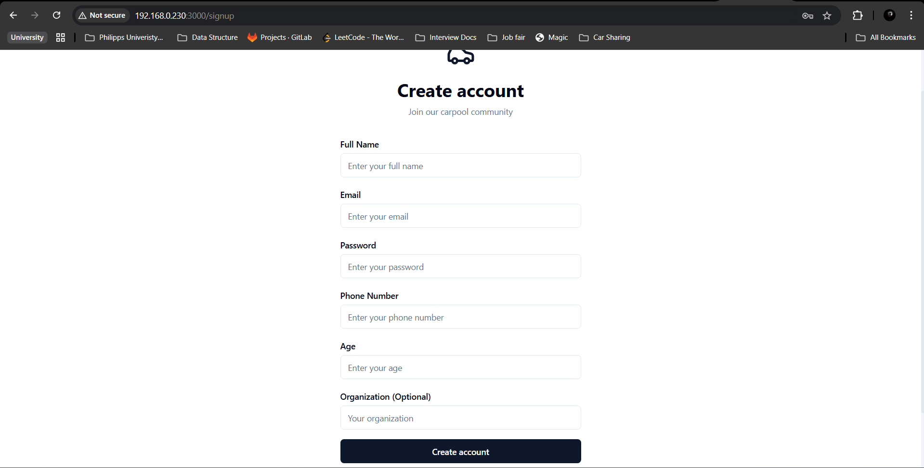

Slide 4
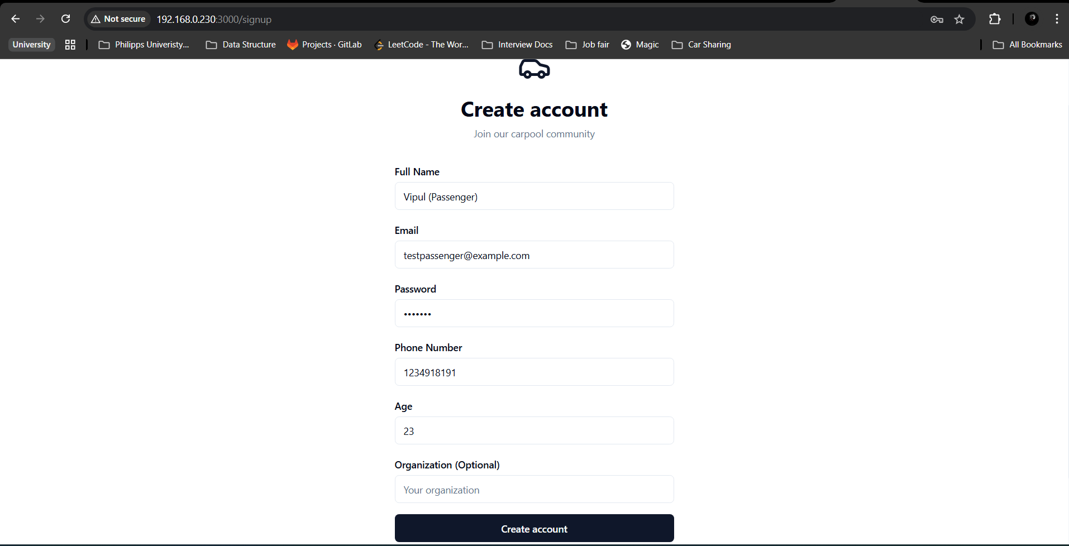

Slide 5
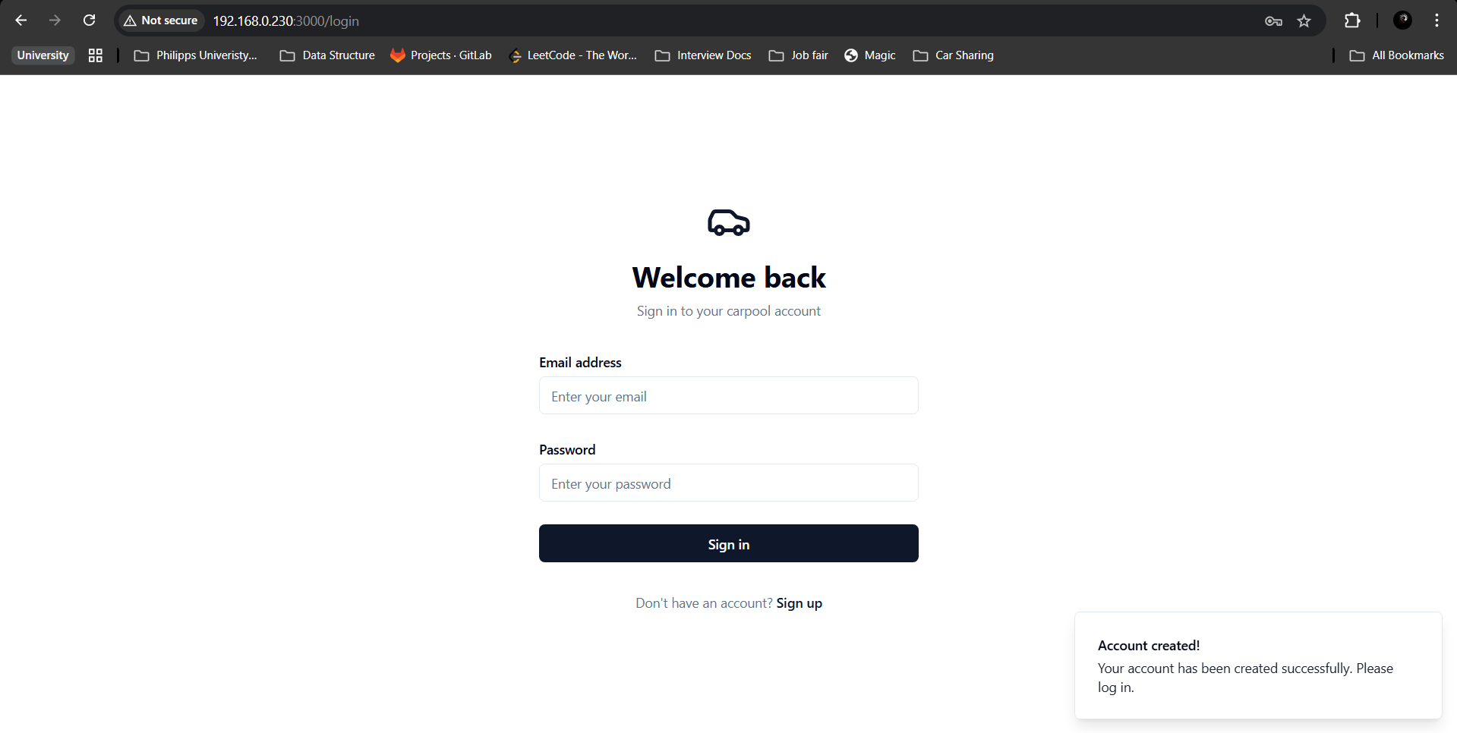

Slide 6
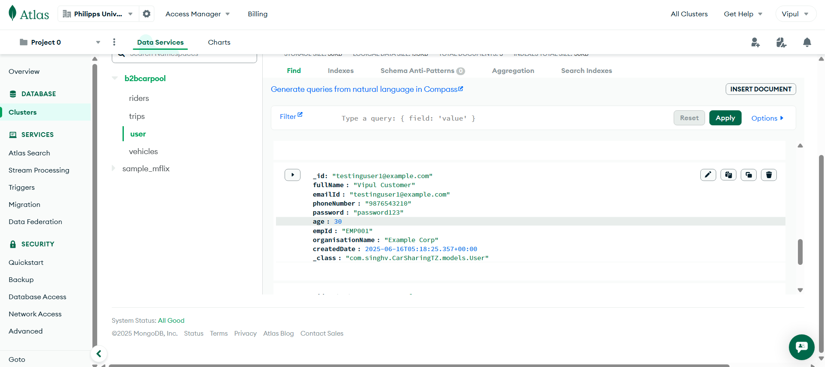

Slide 7
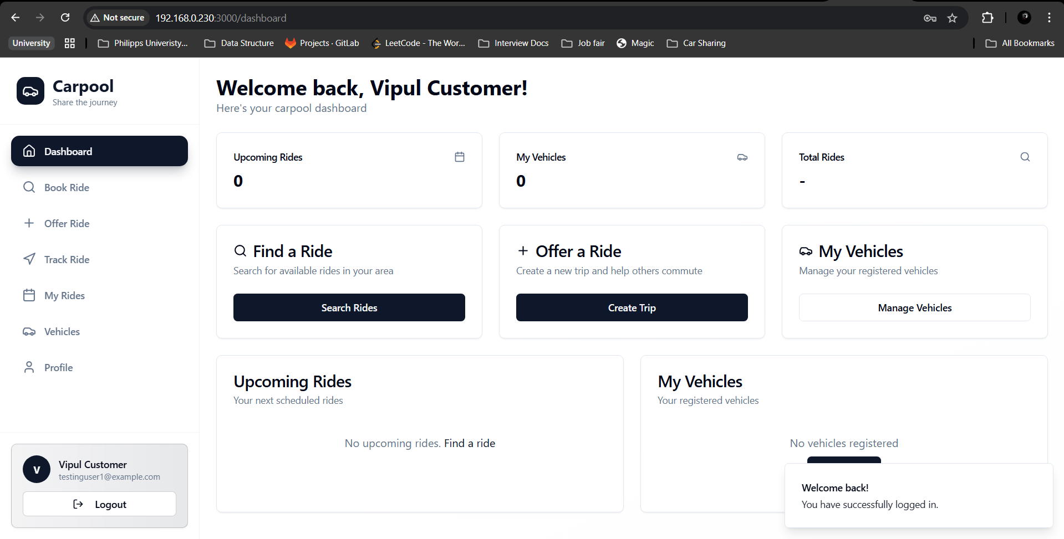

Slide 8
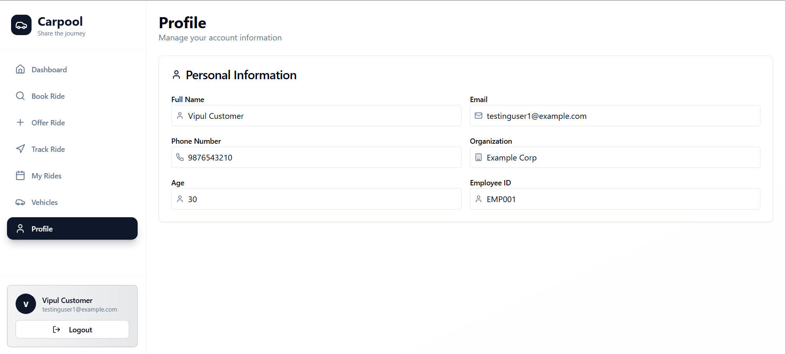

Slide 9
Add New Vehicle Feature
Purpose Allows users to register personal vehicles to offer rides
Implementation:
RESTful API endpoint at /api/vehicles/register
MongoDB database integration for persistent storage
Form validation to prevent duplicate vehicle registrations

Slide 10
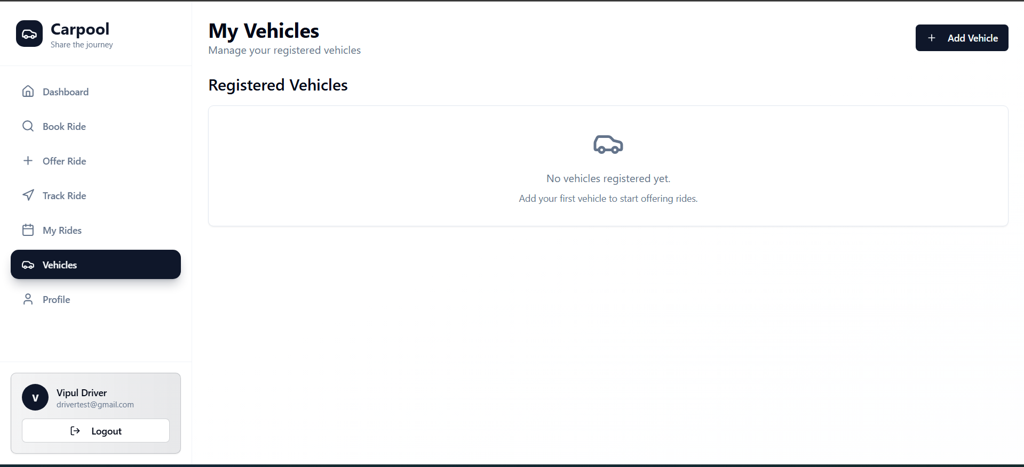

Slide 11
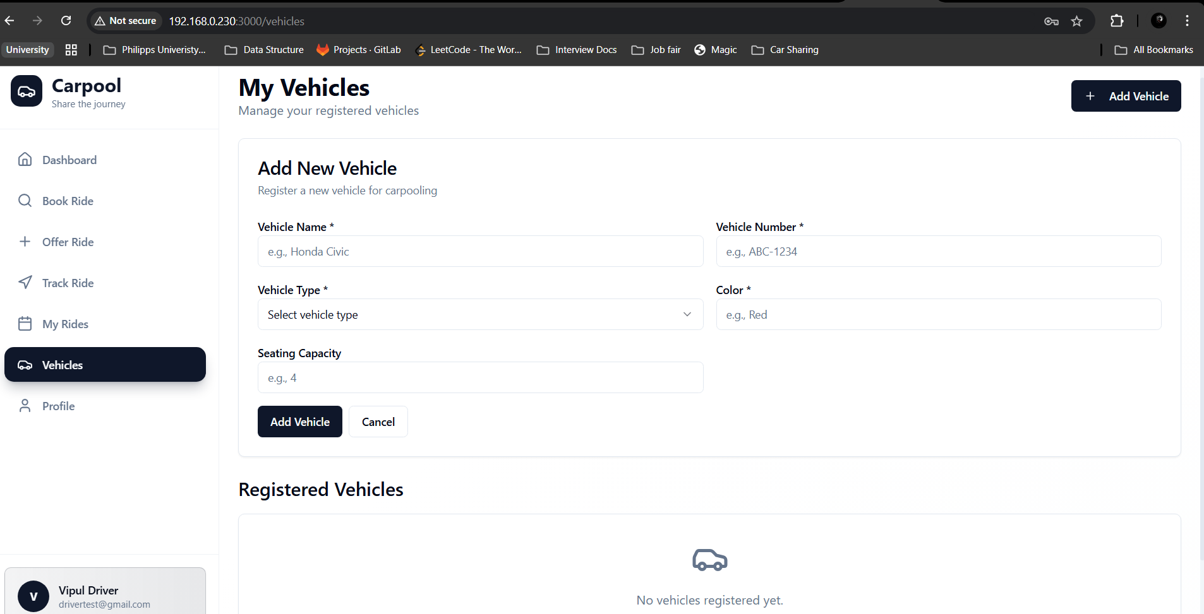

Slide 12
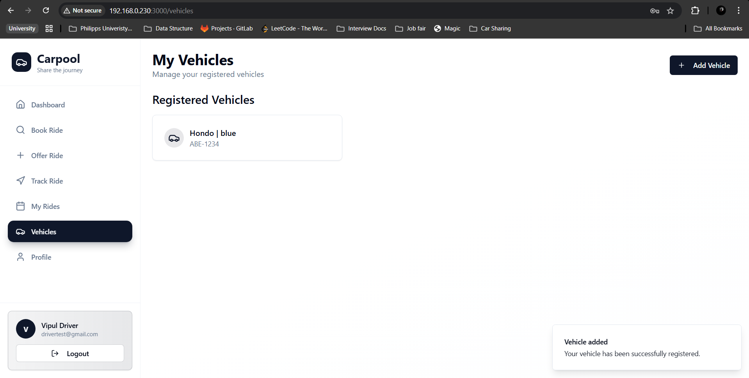

Slide 13
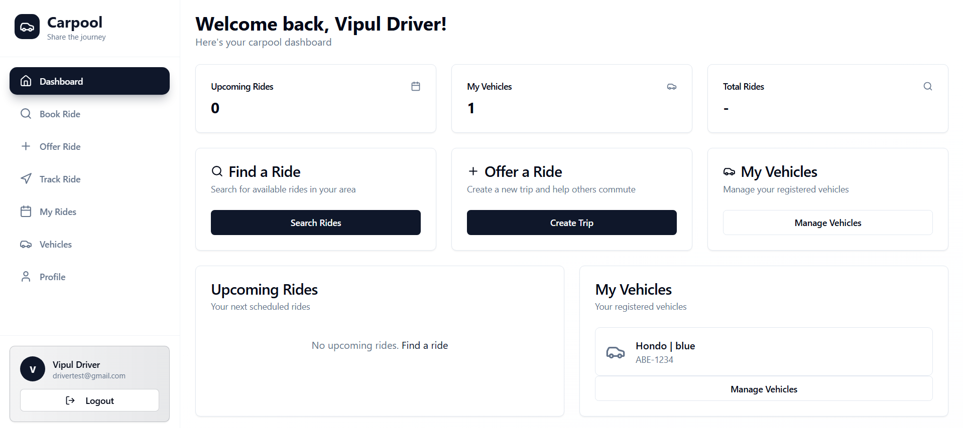

Slide 14
Driver offer Ride Feature and View Upcoming Rides Feature
Purpose: Enables drivers to offer rides by creating new trips
Implementation:
RESTful API endpoint at /api/ride/create-trip
MongoDB storage for trip details
Google Maps API integration for route planning
RESTful API endpoint at /api/myrides/upcoming
Query-based filtering of MongoDB trip records

Slide 15
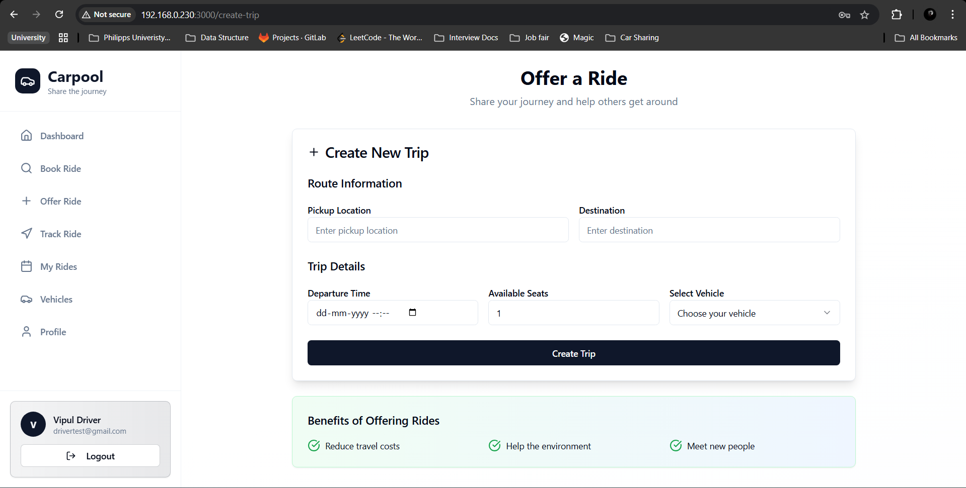

Slide 16
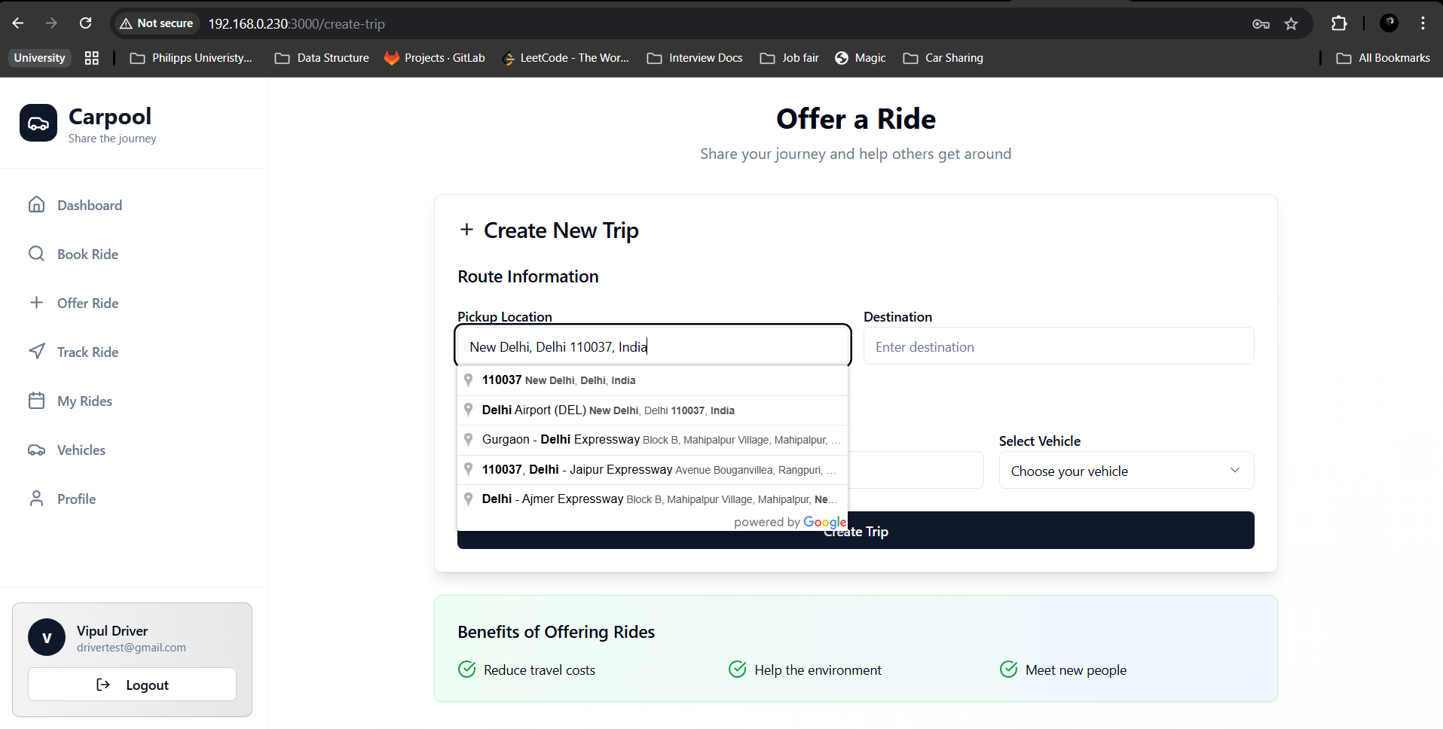

Slide 17
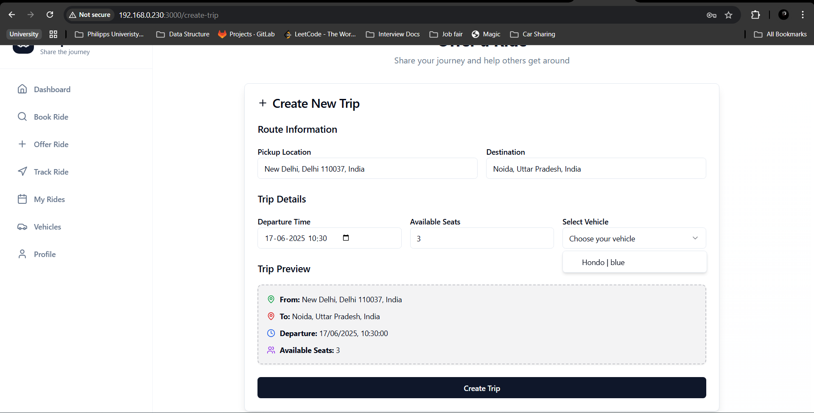

Slide 18
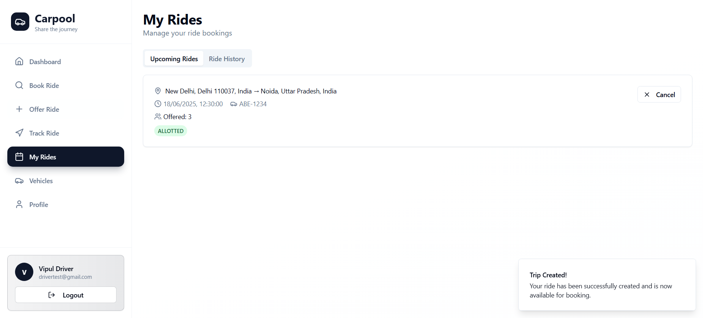

Slide 19
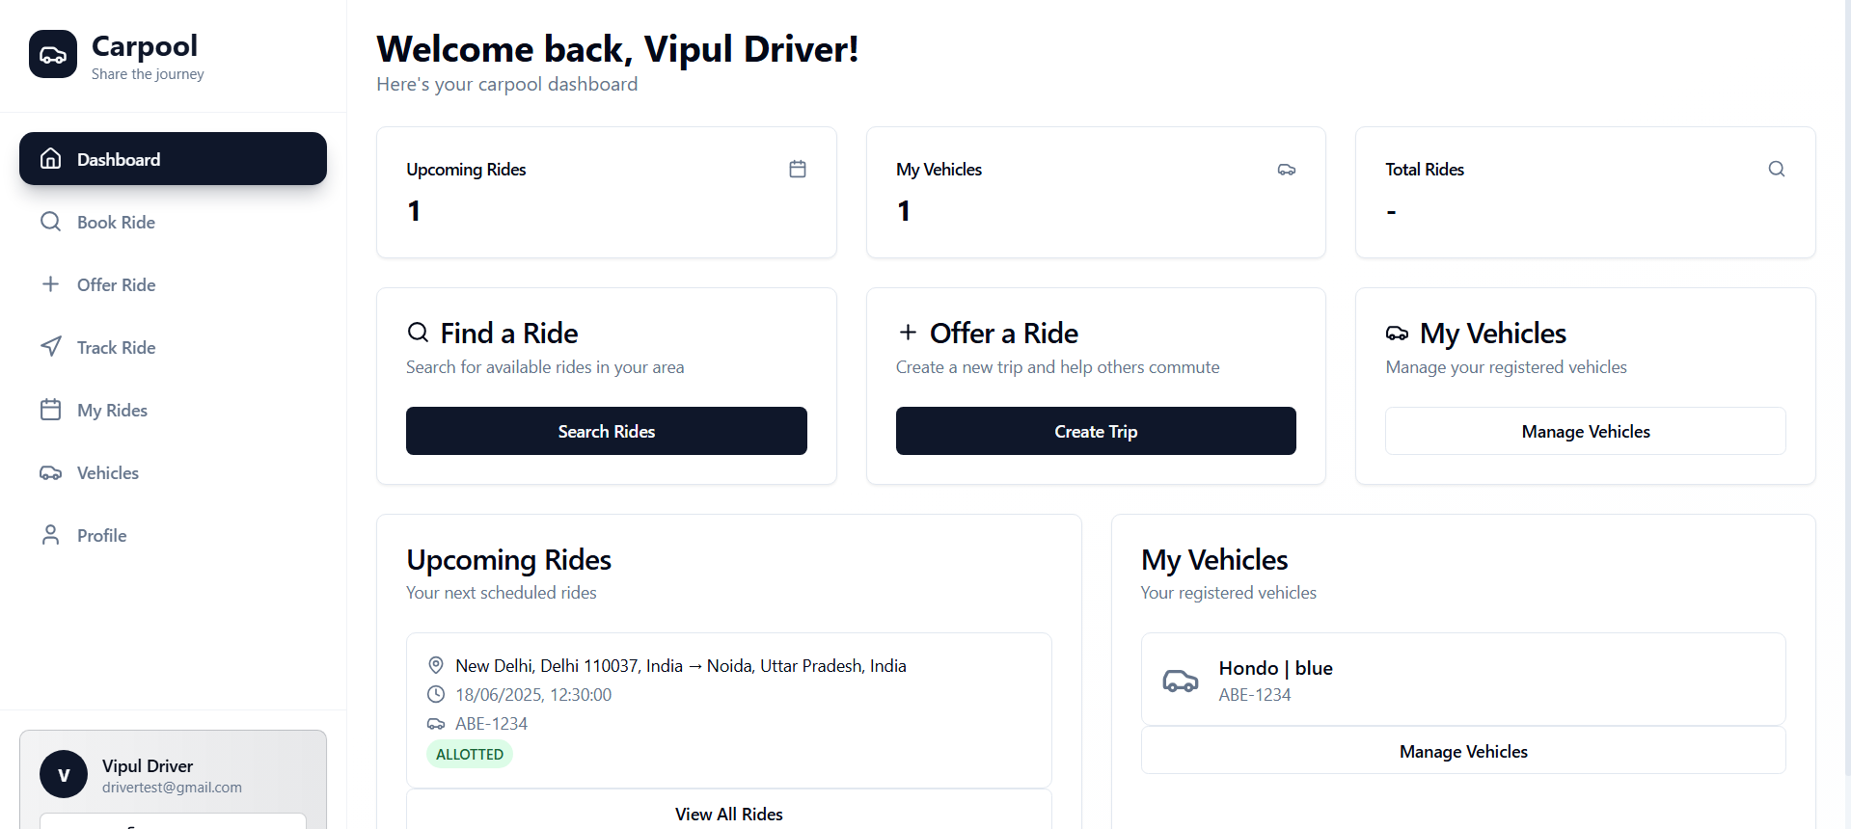

Slide 20
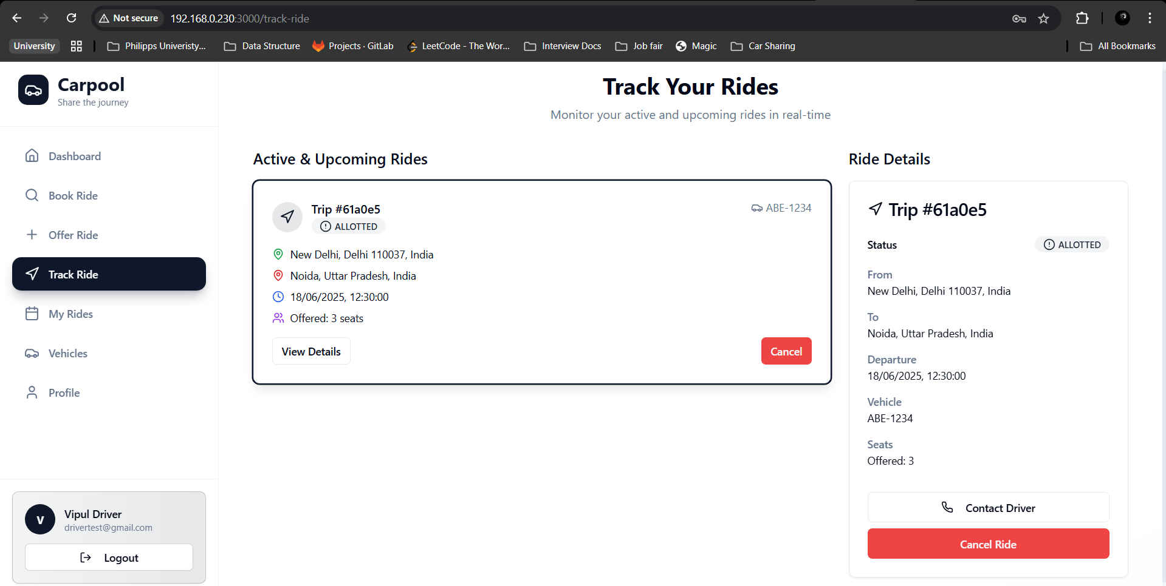

Slide 21
Find a Ride Feature and Book a Ride Feature
Purpose: Helps users find available rides matching their route and time preferences and
allows users to join an existing trip as a passenger
Implementation:
RESTful API endpoint at /api/rides/find-ride
Advanced filtering and matching algorithm
Distance and time optimization
RESTful API endpoint at /api/rides/join-trip
Transaction-based seat reservation

Slide 22
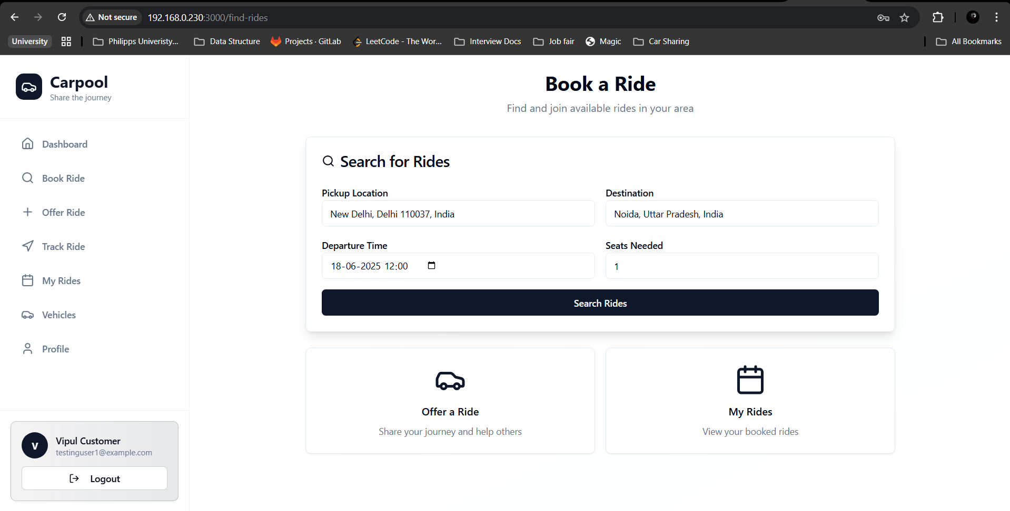

Slide 23
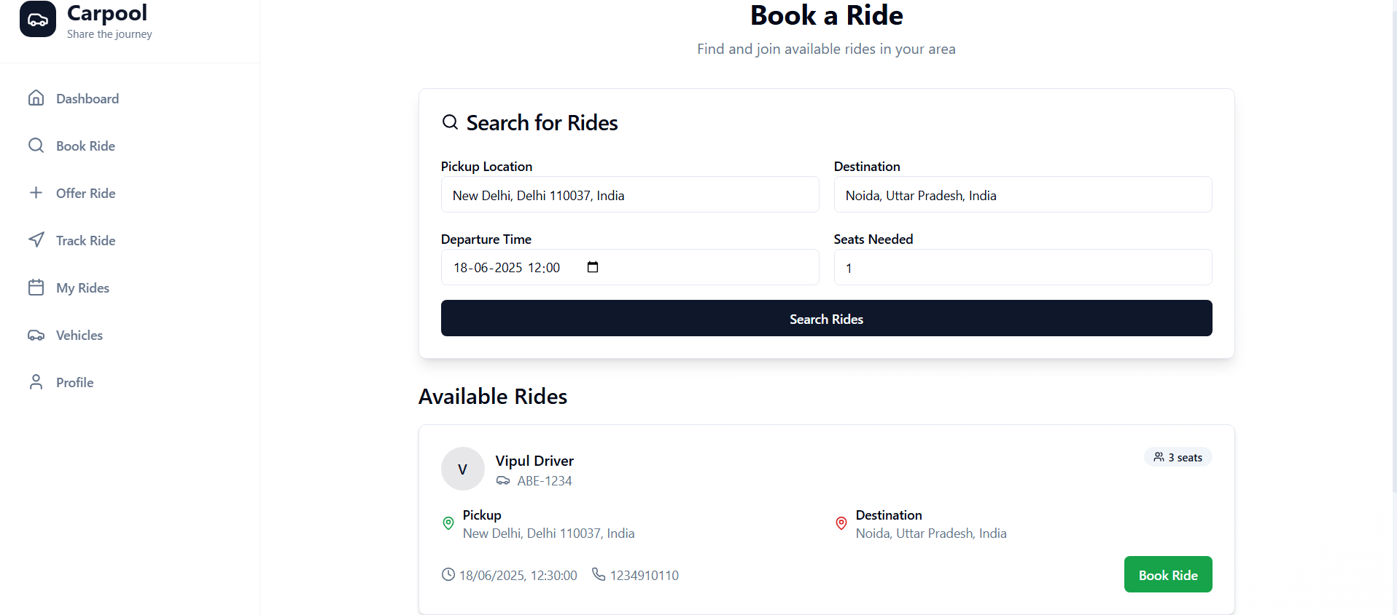

Slide 24
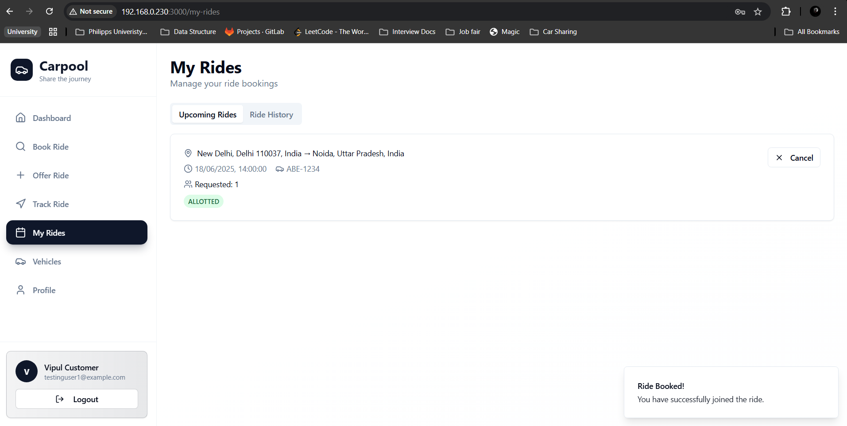

Slide 25
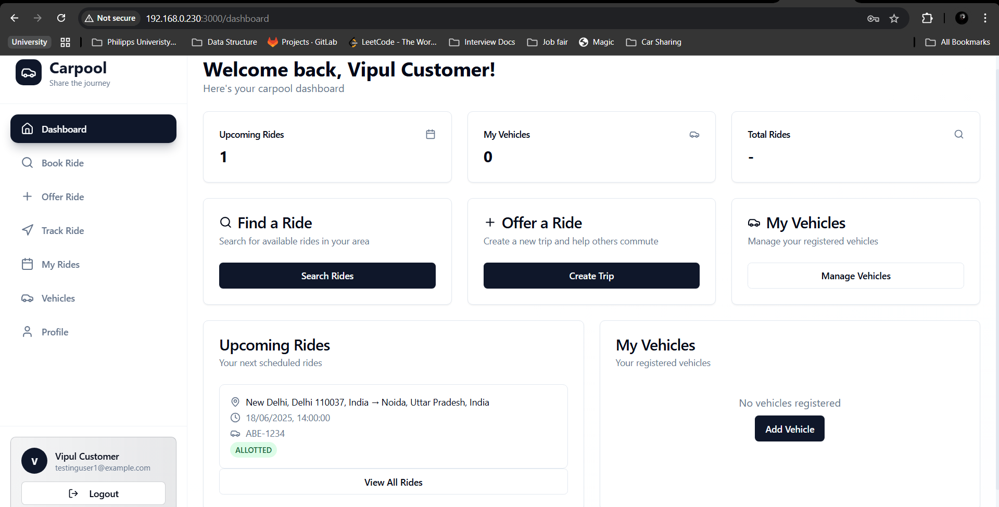

Slide 26
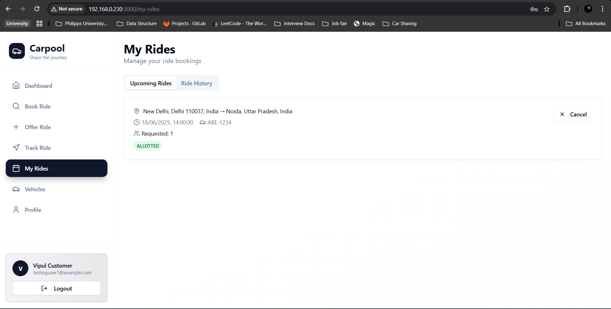

Slide 27
Ride Cancellation Feature
Purpose: Allows both riders and drivers to cancel their participation in trips
Implementation:
RESTful API endpoint at /api/myrides/cancel
Different cancellation workflows for riders vs. drivers
Status tracking for cancellation history

Slide 28
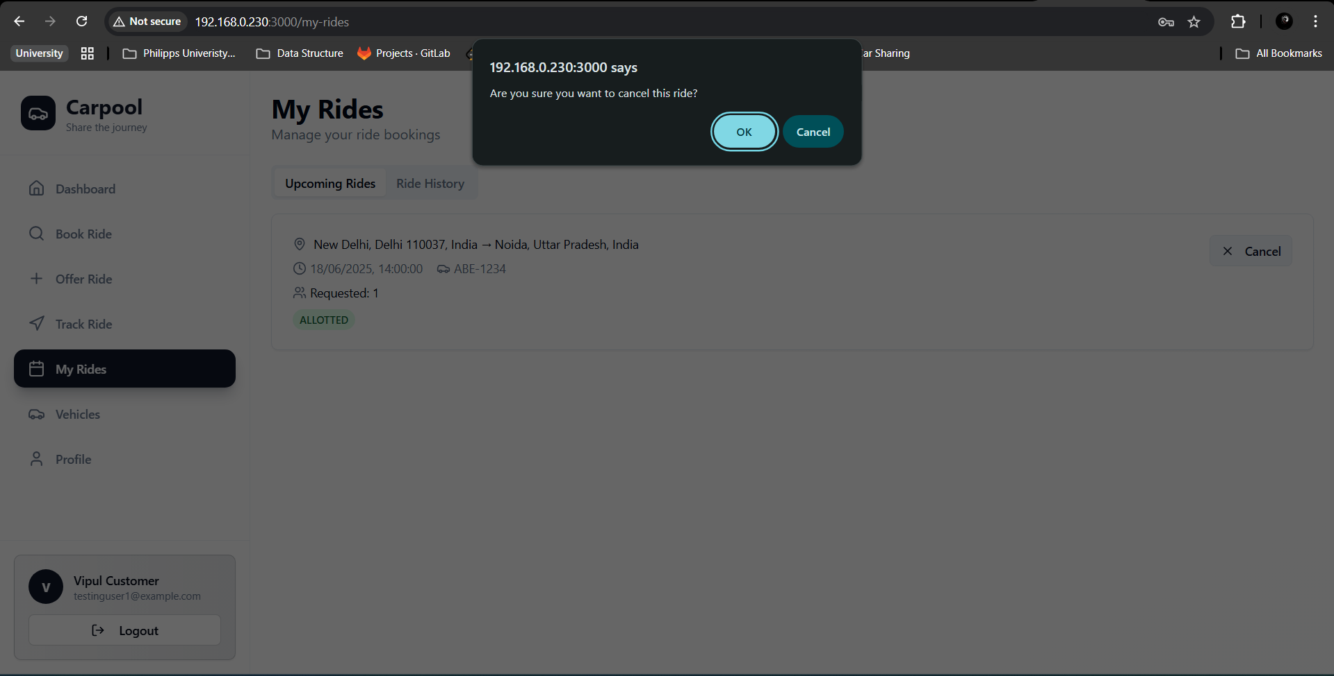

Slide 29
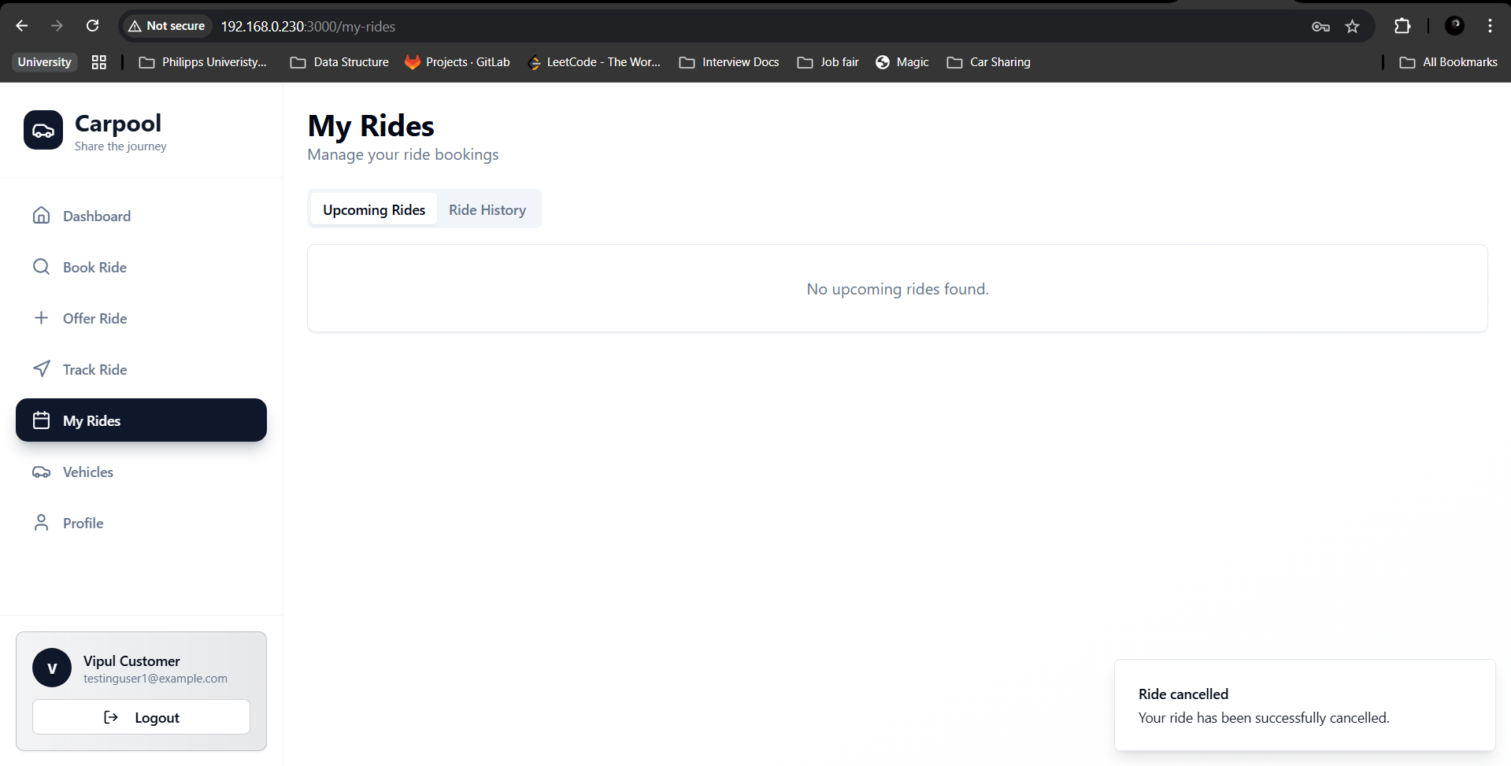

Slide 30
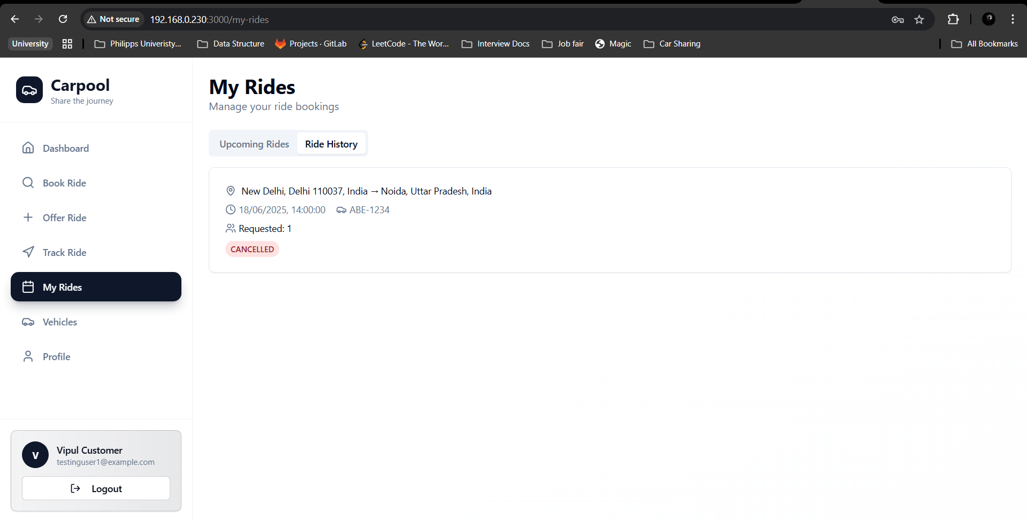

Slide 31
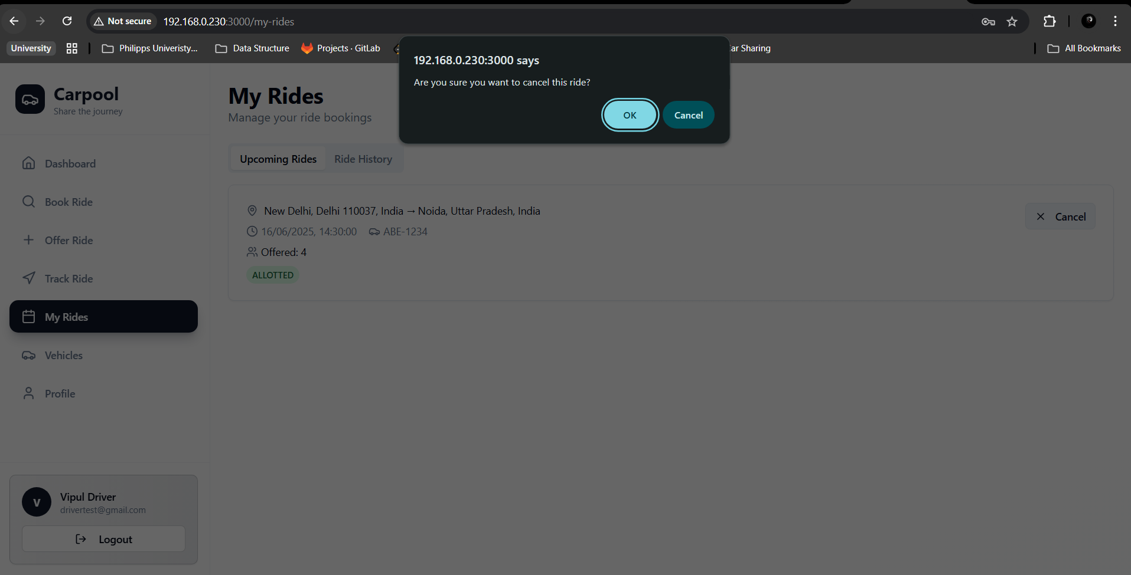

Slide 32
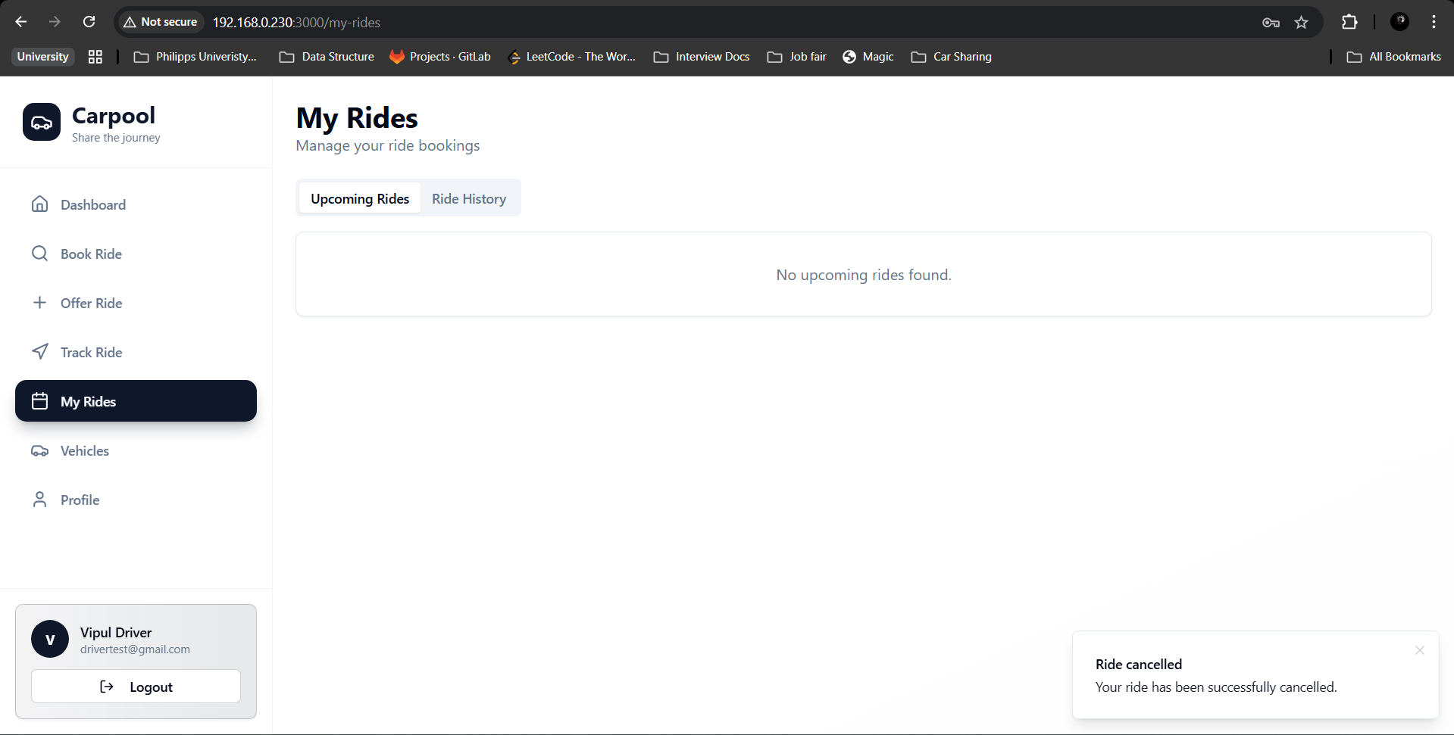

Slide 33
